Slide 1

Teaching Critical Thinking Skills More Creatively
Amy Christensen

Slide 2

Look at what “critical thinking” is.
Justify why we should teach critical thinking skills.
Make hats and try the activity
Brainstorm other ways to teach critical thinking skills
Wrap up

Slide 3

Definition of critical thinking skills
From the Australian Curriculum website:
“Critical thinking is the core of most intellectual activity that involves students in learning to recognize or develop an argument, use evidence in support of that argument, draw reasoned conclusions, and use information to solve problems”.
Examples of thinking skills are:
interpreting analyzing evaluation explaining sequencing reasoning comparing | questioning inferring hypothesizing appraising, testing generalizing”

Slide 4

Why teach critical thinking skills?
1. Write down your answer on your personal white board.
2. Then, form a group of 4 and share your answers.
3. Choose one of the answers to share with the large group.

Slide 5

My top 3 reasons are you need these skills in…
1. College
2. Career
3. Life

Slide 6

21st Century Skills
1. Critical Thinking and Problem Solving
2. Collaboration and Leadership
3. Agility and Adaptability
4. Initiative and Entrepreneurialism
4. Effective Oral and Written Communication
5. Accessing and Analyzing Information
6. Curiosity and Imagination
Source: Tony Wagner, The Global Achievement Gap

Slide 7






Edward Bono’s 6 Thinking Hats
"The main difficulty of thinking is confusion," writes Edward de Bono.
WHITE HAT: neutral and objective, concerned with facts and figures
RED HAT: the emotional view
BLACK HAT: careful and cautious, the "devil's advocate" hat
YELLOW HAT: sunny and positive
GREEN HAT: associated with growth, creativity, and new ideas
BLUE HAT: organizing hat

Slide 8
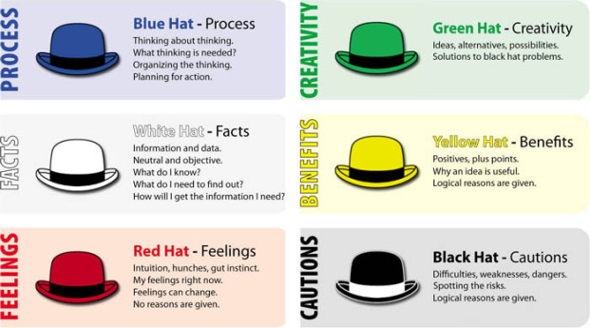

Slide 9

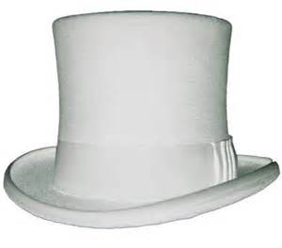
White Hat: (Logic hat)
Focus on the data available.
Look at the information you have, and see what you can learn from it.
Yellow Hat: (Positive hat)
Think positively.
Choose an optimistic viewpoint that helps you to see all the benefits of the decision.

Slide 10
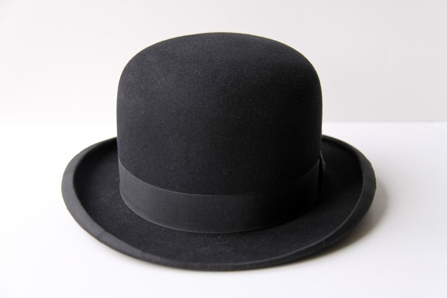

Red Hat: (Emotion Hat)
Look at the situation using your intuition and emotion.
Try to understand the responses of people who do not fully know your reasoning.
Black Hat: (Pessimist Hat)
Look at all the bad points of the decision. Try to see why it might not work.
Remember that Black Hat thinking helps to make your plans 'tougher' and more resilient.
Identify risks!

Slide 11


Green Hat: (Creative Hat)
Develop creative solutions to a problem.
Express new concepts and new perceptions.
Anticipate what the pros and cons are and come up with creative solutions.
Blue Hat: (Process Hat)
Monitor the other 5 groups by walking around and checking on progress.
Ask probing or clarification questions if needed.

Slide 12
Solve the problems your group gets using the 6 Hat Thinking.
1. Your friend has high blood pressure. He eats a lot of fast food. He works long hours and spends his free time watching TV. He asked you for advice to get healthier.
What are you going to tell him?
2. Your cousin wants to buy a brand new car, but you think he should buy a used one.
What can you say to him to help him think about his options?
3. You own a successful food truck that is parked at CNM. You heard a new truck is going to be parked next to yours in a week.
How can you keep your existing customers?

Slide 13
Fun Fact: Who uses it?
A method for effective team meetings, problem solving, decision making and proposal/design evaluation.
Can be used in businesses, schools and families for resolving issues and making decisions.
Major organizations using Six Thinking Hats are:
NASA IBM Siemens Microsoft Prudential Insurance | British Airways Speedo, Federal Express Pepsico DuPont

Slide 14
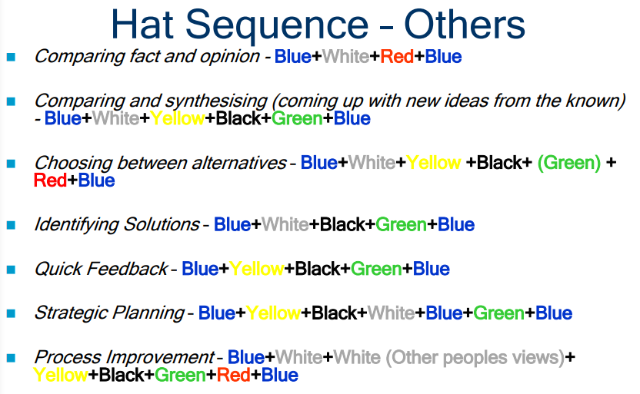

Slide 15
Using the hats
1. Use blue hat at the beginning and end. Blue hat is usually worn by the facilitator.
2. Use any hat, as often as needed Hats can be used individually at any point or as a sequence of two, three, four or more hats.
3. Sequence can be preset or evolving Not necessary to use every hat!
4. Time under each hat: generally, short
5. Requires discipline from each person to stay focused.
6. Adds an element of play
7. Can be used by individuals and groups.

Slide 16
Benefits of using the 6 Thinking Hats
Maximize productive collaboration and minimize counterproductive interaction/behavior Consider issues, problems, decisions, and opportunities systematically Generate more, better and innovative ideas and solutions Reduce conflict among team members Create dynamic, results oriented meetings that make people want to participate | Think clearly and objectively View problems from new and unusual angles See all sides of a situation Go beyond the obvious to discover effective alternate solutions Spot opportunities where others see only problems From: http://www.debonogroup.com/six_thinking_hats.php

Slide 17

How would you use this technique?

Slide 18
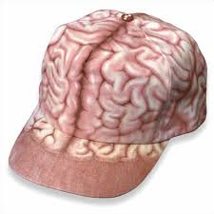
Thank you for your attention!
I appreciate you putting on your “thinking caps”!

