Slide 1
Cultivating Information Literate ELLs in the University EAP Classroom
A Project-Based Approach
Dr. Xiaofei Rao & Dr. Wenjie Wang
College of Education
The School of TPAL
C. Dr.s Rao and Wang

Slide 2
NM TESOL SPRING WORKSHOP, Feb. 9, 2019
Sm 102, cnm

Slide 3
Presentation Agenda
Information literacy: Questionnaire survey, definitions, development, and value;
What literature informs us: Studies in U.S. and Chinese Universities;
Project-Based Learning (PBL) approach;
Framework of our 4-week research project;

Slide 4
Presentation Agenda
What Data informs us: Student voices;
Educational implications;
Minds-on & Hands-on: Creating a mini-project;
Q & A time.

Slide 5

Information Literacy Questionnaire
Individual: information literacy survey;
Brainstorming: exchange ideas about information literacy in use.

Slide 6
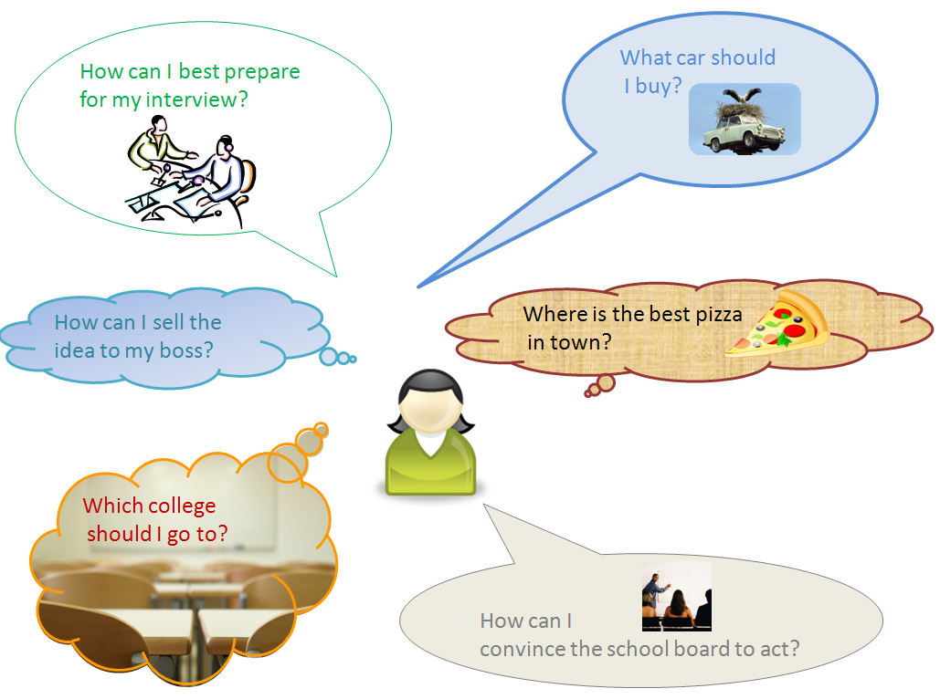

Slide 7
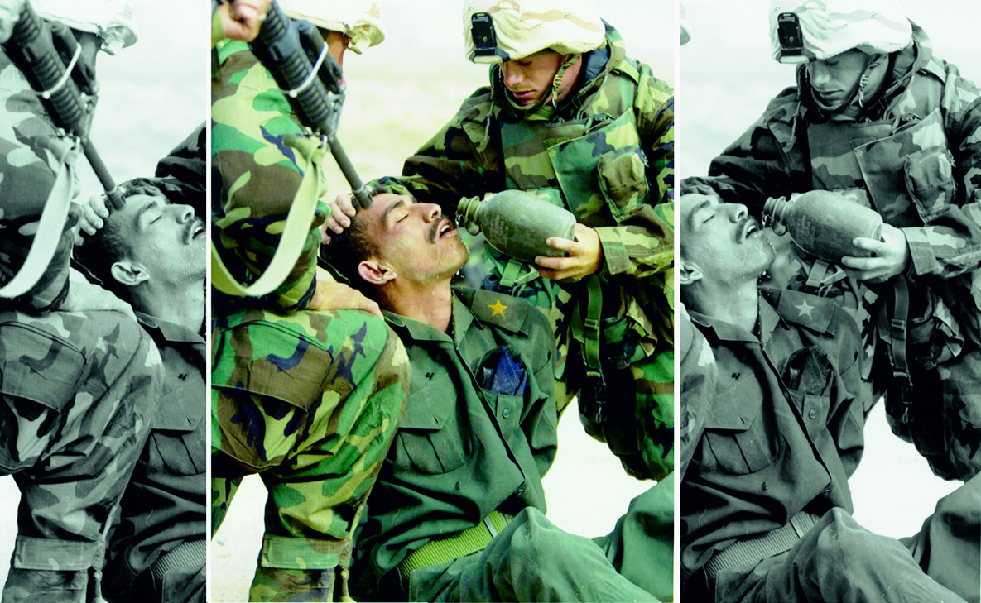

Slide 8
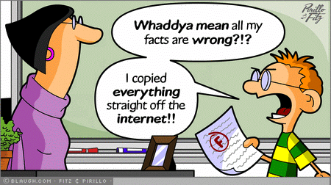

Slide 9


Slide 10
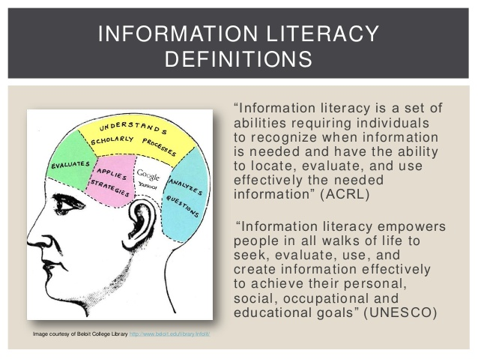
Source: "Information Literacy Competency Standards for Higher Education". ala.org/acrl. Association of College & Research Libraries (ACRL). Archived from the original on 2017-06-21. Retrieved 2019-02-05.

Slide 11
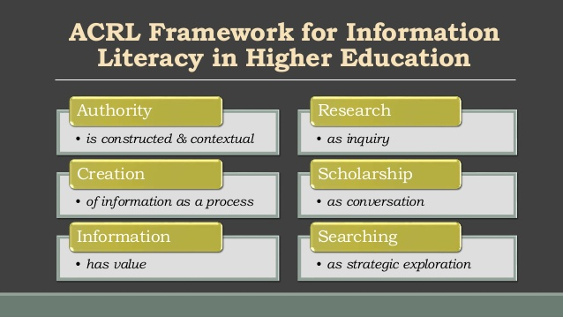
source: https://acrl.ala.org/framework/

Slide 12
What Literature Informs Us I
IL integration in U.S. University EAP classrooms:
Conteh-Morgan, M. (2002). Connecting the Dots: Limited English proficiency, second language learning theories, and information literacy instruction.
Badke, W. (2002). International students: Information literacy or academic literacy.
Healey, M. (2005). Linking research and teaching to benefit student learning.
Hearn, M. R. (2005). Embedding a librarian in the classroom: An intensive information literacy model.
Mills, V. & Sult, L. (2006). A blended method for integrating informatjion literacy instruction into English composition classes.
Holiday, W. & Fagerheim, B. A. (2006). Integrating information literacy with a sequenced English composition curriculum.

Slide 13
What Literature Informs Us II
IL integration in Chinese University EAP classrooms:
Wang, H. (2010). The training strategies of English majors’ information literacy competency in thesis writing.
Peng, Z. & Wang, R. (2014). Improving students’ information literacy through university English courses.
Ouyang, L. (2017). On the importance of integrating information literacy education in college English courses.

Slide 14
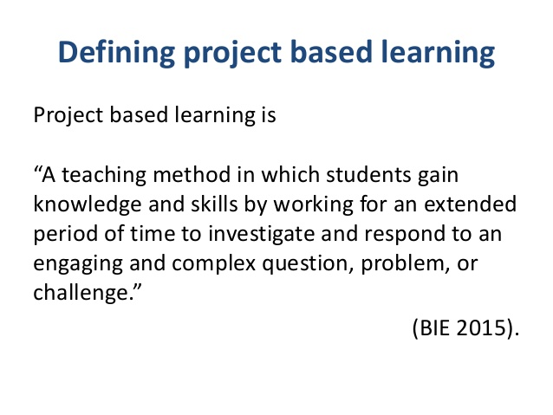

Slide 15
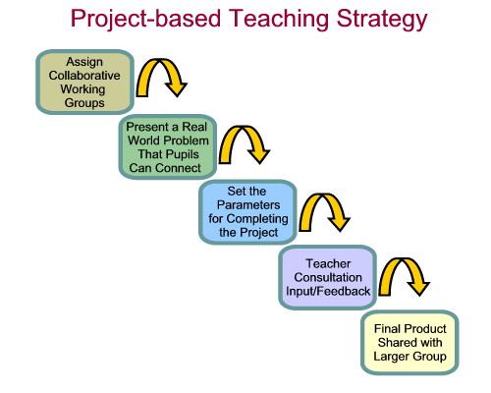

Slide 16
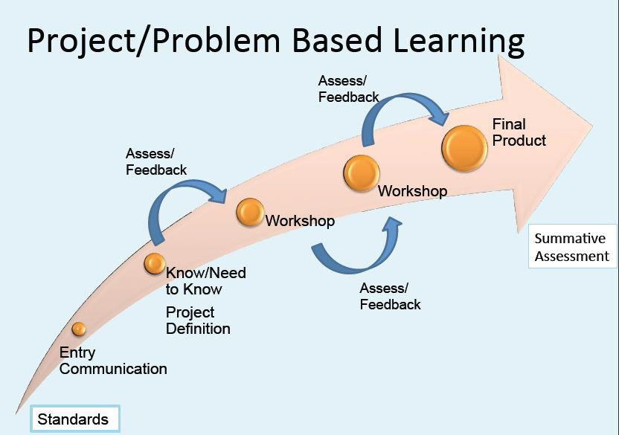

Slide 17
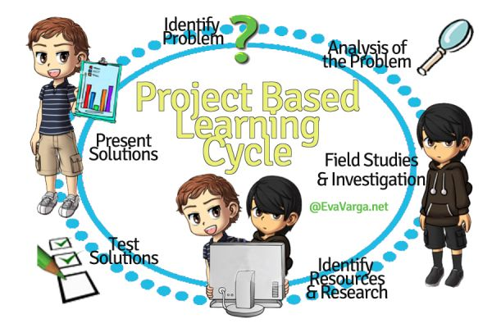
PBL & University EAP in Action

Slide 18
PBL Approach: Applied in
University EAP Research
Reports from U.S. and Chinese universities:
Levis, J. M. & Levis, G. M. (2003). A project-based approach to teaching research writing to nonnative writers.
Grant, S. (2017). Implementing project-based language teaching in an Asian context: a university EAP writing course case study from Macau.
Li, Y. & Wang, L. (2018). An ethnographic exploration of adopting project-based learning in teaching English for academic purposes.

Slide 19
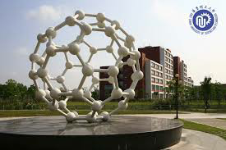

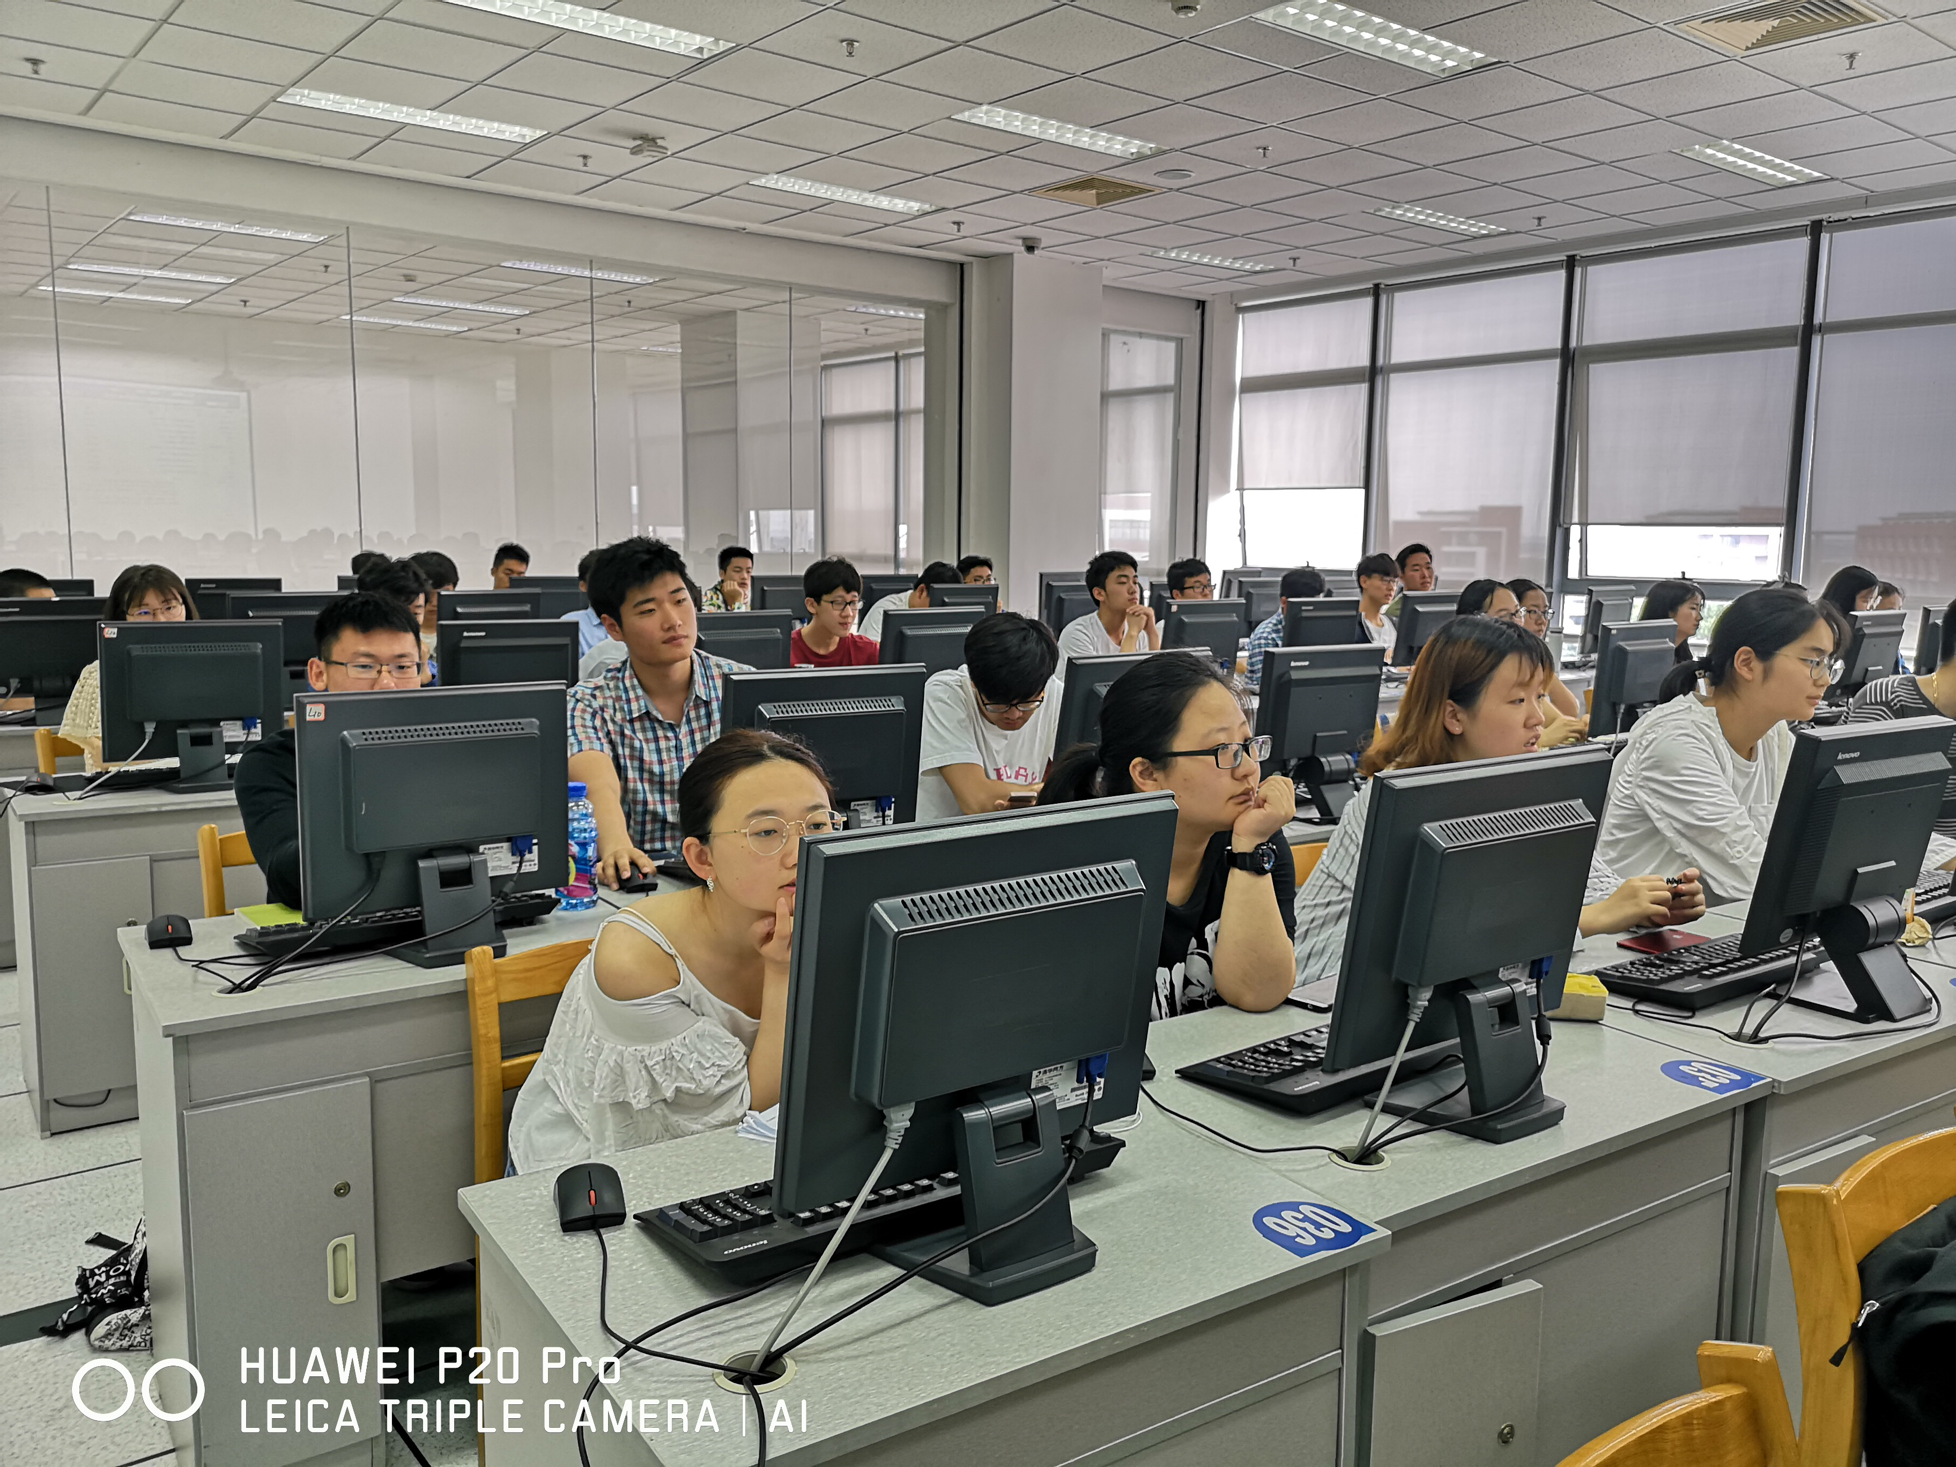
Introducing the Context
University setting
Student cohort
University EAP course
Text materials in use
Assessment

Slide 20
Our Project’s Framework
Framework of our 4-week research project:
Initial stage: Week 1
Move-on: Week 2-3, part of Week 4
Speech in public: Week 4
Reflective flames: Week 4 and onward

Slide 21
Implementing PBL Approach I
Initial stage (1st half of week 1)
In-class activities:
Research project month scheduled and announced;
Research theme provided (Survival in the 1st Year in University) and research timeline announced;
Group division with team leader and time moderator;
Class brainstorming on available resources;
Teacher as a facilitator with support and guidance.

Slide 22
Implementing PBL Approach I
Initial stage (1st half of week 1)
After-class activities:
Group decision on a focused research topic;
Groups using library database and/or other resources to retrieve literature;
Collected articles assorted with bibliography and summary writing.

Slide 23
Implementing PBL Approach I
Initial stage (2nd half of week 1)
In-class activities:
5-mins group report with PPT on its research topic with collected journal articles;
5-mins Q&A and feasibility assessment from teacher and other groups;
Teacher as a facilitator with support and guidance.

Slide 24
Implementing PBL Approach I
Initial stage (2nd half of week 1):
After-class activities:
Research topic revision as per assessments;
Each group continued to retrieve more literature;
Literature read with bibliography and summary writing;
Group-based 1st reflection writing (progress & difficulties recorded).

Slide 25

Implementing PBL Approach II
Move-on (Week 2-3, part of Week 4)
More information literacy tasks and research-based writing tasks were assigned and implemented to groups with teacher support and guidance.

Slide 26
Implementing PBL Approach II
Move-on (1st half of Week 2)
In-class activities:
Class brainstorming research methods based on topic and literature read;
5-mins group report with PPT on research method(s) intended to use;
5-mins Q&A and feasibility assessment from teacher and other groups;
Teacher as a facilitator with support and guidance.

Slide 27
Implementing PBL Approach II
Move-on (1st half of Week 2)
After-class activities:
Group revision of research method(s) as per assessments;
Research project implementation by group;
Teacher as a facilitator with support and guidance.

Slide 28
Implementing PBL Approach II
Move-on (2nd half of Week 2)
In-class activities:
Research proceeded with qual./quan./mixed methods within each group;
Research questionnaire/survey/interview design;
Teacher as a facilitator with support and guidance.

Slide 29
Implementing PBL Approach II
Move-on (2nd half of Week 2)
After-class activities:
Questionnaire distributed, survey/interview conducted, and literature revisited;
Data collected and assorted;
Group-based 2nd reflection writing (progress & difficulties recorded).

Slide 30
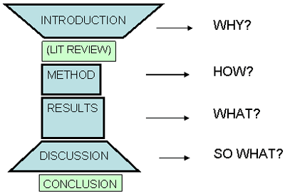
Implementing PBL Approach II
Move-on (1st half of Week 3)
In-class activities:
The IMRD structure revisited in in research paper writing;
Continued work on data collection and analysis;
Teacher as a facilitator with support and guidance.
After-class activities:
Continued work on data analysis.

Slide 31
Implementing PBL Approach II
Move-on (2nd half of Week 3)
In-class activities:
1st draft writing;
Teacher as a facilitator with support and guidance.
After-class activities:
Continued work on 1st draft wring;
Submission upon completion over the weekend;
Group-based 3rd reflection writing (progress & difficulties recorded).

Slide 32
Implementing PBL Approach II
Move-on (1st half of Week 4)
In-class activities:
Group revision of the draft as per teacher feedback;
Other parts, i.e. Abstract, Key words, and References, to be completed.
After-class activities:
Final draft completed and submitted before deadline;
5-mins group presentation with PPT prepared.

Slide 33
Implementing PBL Approach III
Speech in public (2nd half of Week 4)
In-class activities:
Presentation assessment form distributed;
5-mins oral group presentation with PPT ;
Assessments done by teacher and the rest groups;
Comments by teacher.
After-class activities:
Group-based 4th reflection writing (progress & difficulties recorded).

Slide 34
Implementing PBL Approach IV
Reflective flames (onward)
Submission of 4 week-based reflection writings with group member signatures;
Submission of a personal reflection journal on benefits and challenges one had during the project with comments/suggestions on future work;
All submissions kept in student portfolios;
Whole class activity: Reflection journals matter.

Slide 35
What Data Informs Us
Student voices on (from reflection journals and interviews):
Scientific research awareness and attitudes;
Information literacy skills;
EAP learning;
Scholarly writing;
Cooperative work/community building;
Leadership.

Slide 36
Educational Implications
Revisiting ELLs’ learning needs:
Academic language competency;
Information literacy;
Academic scholarship;
Scientific literacy.

Slide 37
Minds-on & Hands-on:
Creating a mini-project
Step 1
group division with a driving research theme.
Step 2
taking on the role of project designer and narrowing down topic and creating a research question.
Step 3
leading information searching and researching
Step 4
critical analyzing based on gathered information and evaluating gathered information
Step 5
summarizing and synthesizing
Step 6
checking further inquiry, questioning and exploratory investigations
Step 7
responding research questions and preparing to present the project
Step 8
presenting project and taking feedback
Step 9
reflecting on the whole process by groups
Step 10
whole class reflection

Slide 38
Your Turn: Minds-on & Hands-on
Reflect on
Reflect on this project and think about your classroom dynamics, create a mini-project that incorporates information literacy skills.
Create
Further create an agenda of the mini-project that you can conduct it with your students within a certain timeline.
Discuss
Discuss with your group members and seek some suggestions.
Share
Share your mini-project with everyone.

Slide 39
Q & A Time

Slide 40
Dr. Xiaofei Rao & Dr. Wenjie Wang
College of Education
The School of TPAL
575-449-9431 (Rao)
575–571-9694 (Wang)
mariarxf@nmsu.edu; wenjie@nmsu.edu

